Slide 1
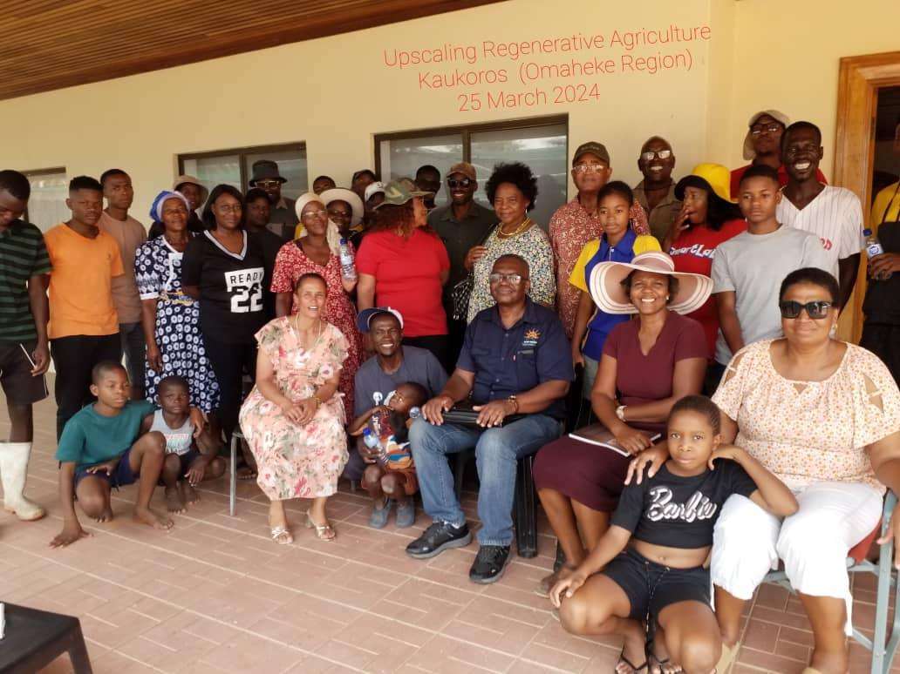
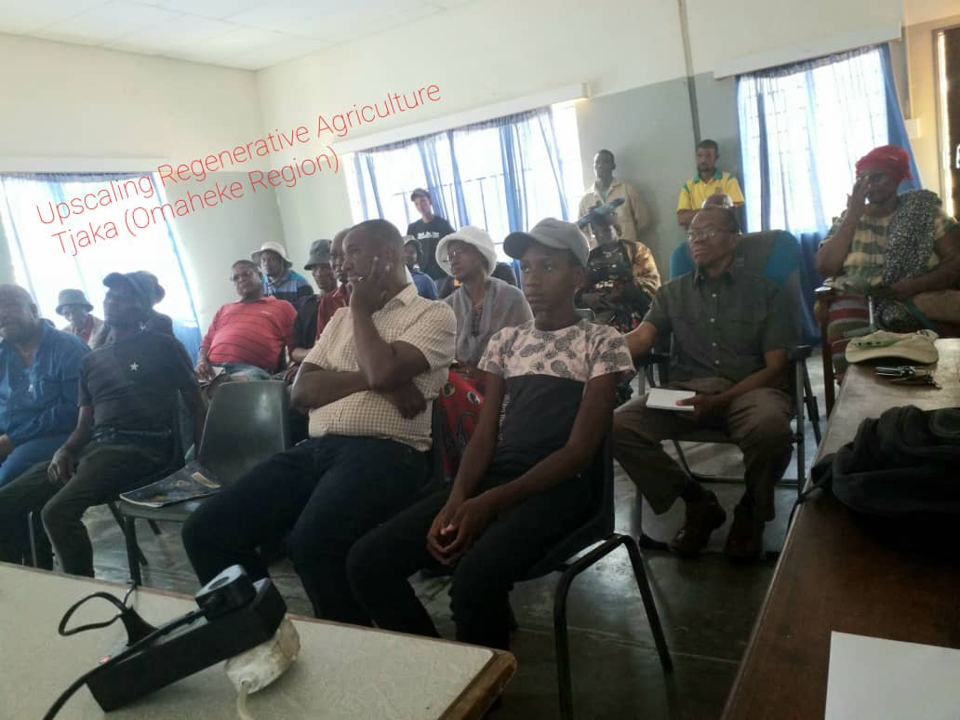
REGENERATIVE AGRICULTURE TRAINING IN Kaukururs & Tjaka

Slide 2
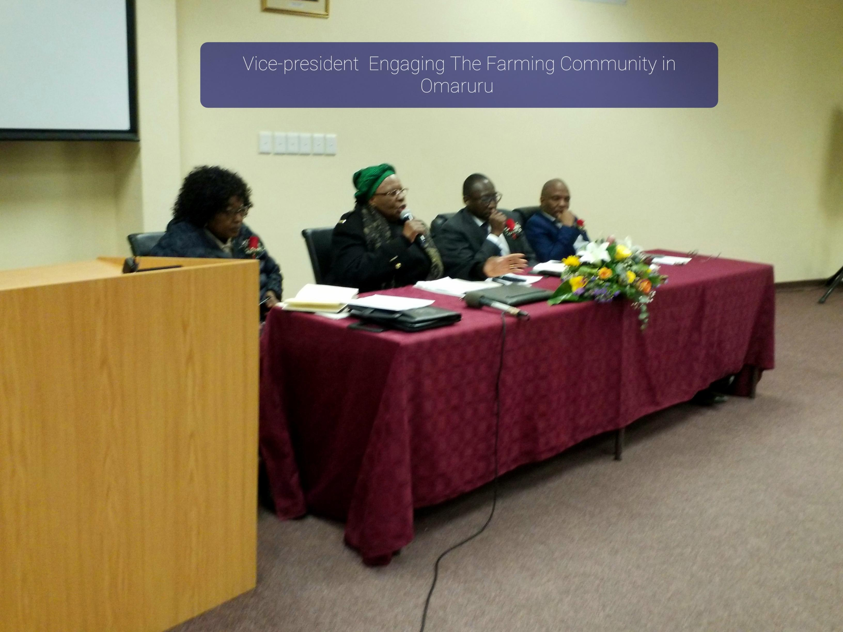
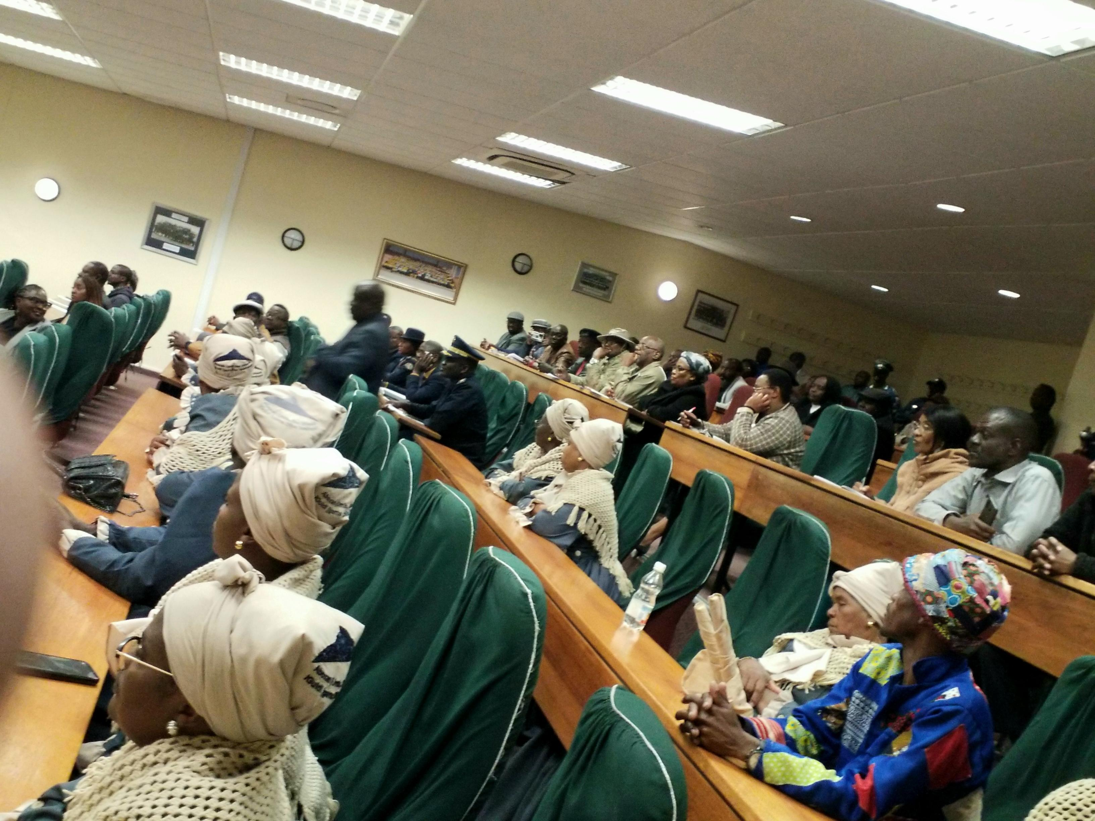
VICE-PRESIDENT FARMERS’ ENGAGEMENT IN OMARURU

Slide 3
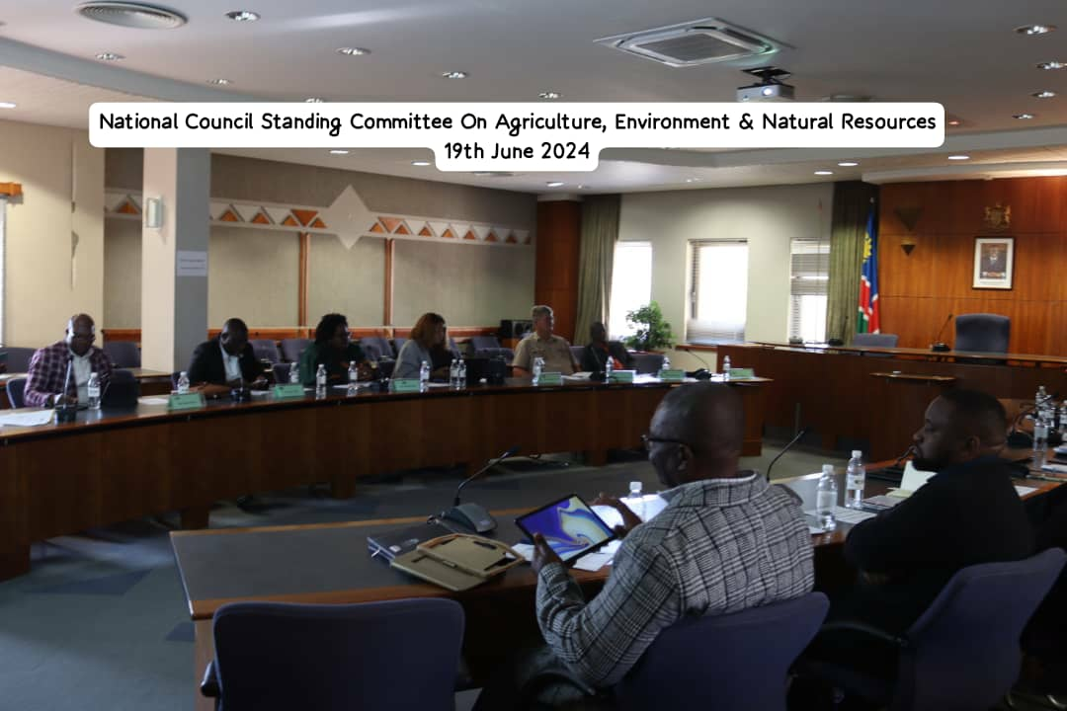
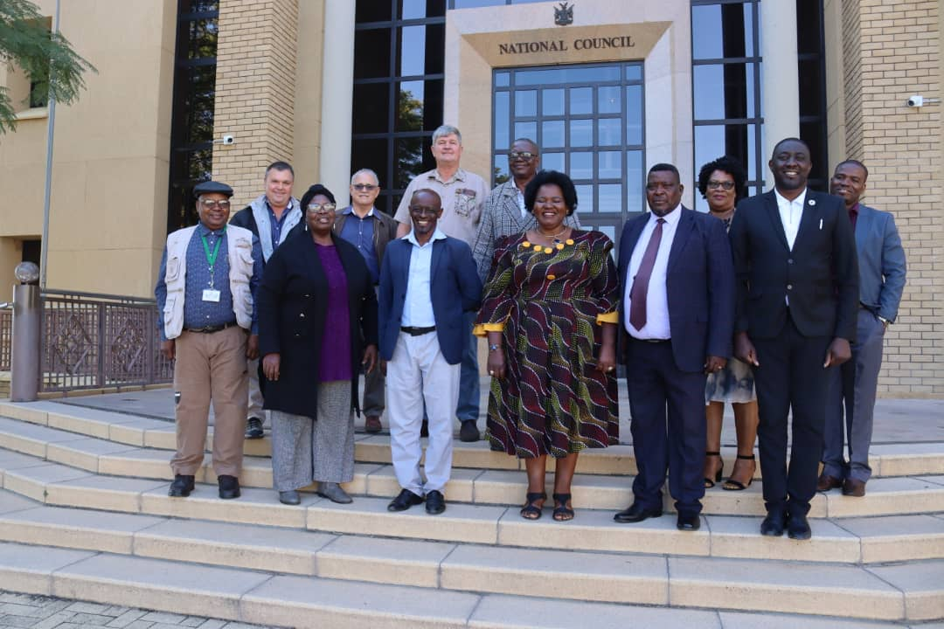
Stakeholder Engagement with the National Council on Agriculture, Environment & Natural resources

Slide 4
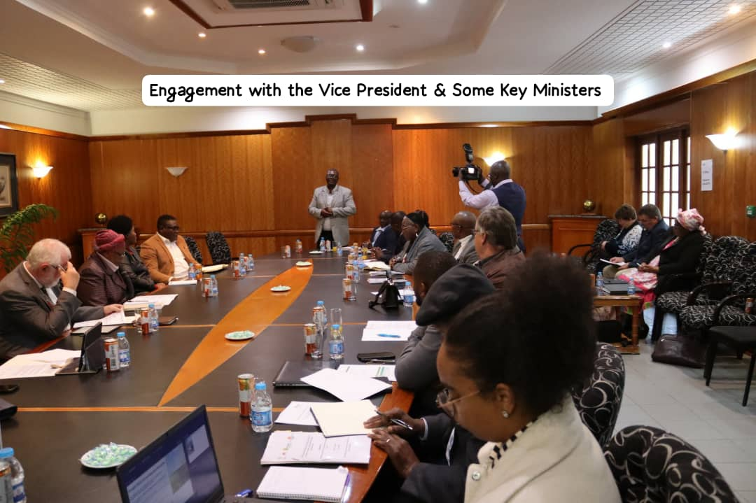
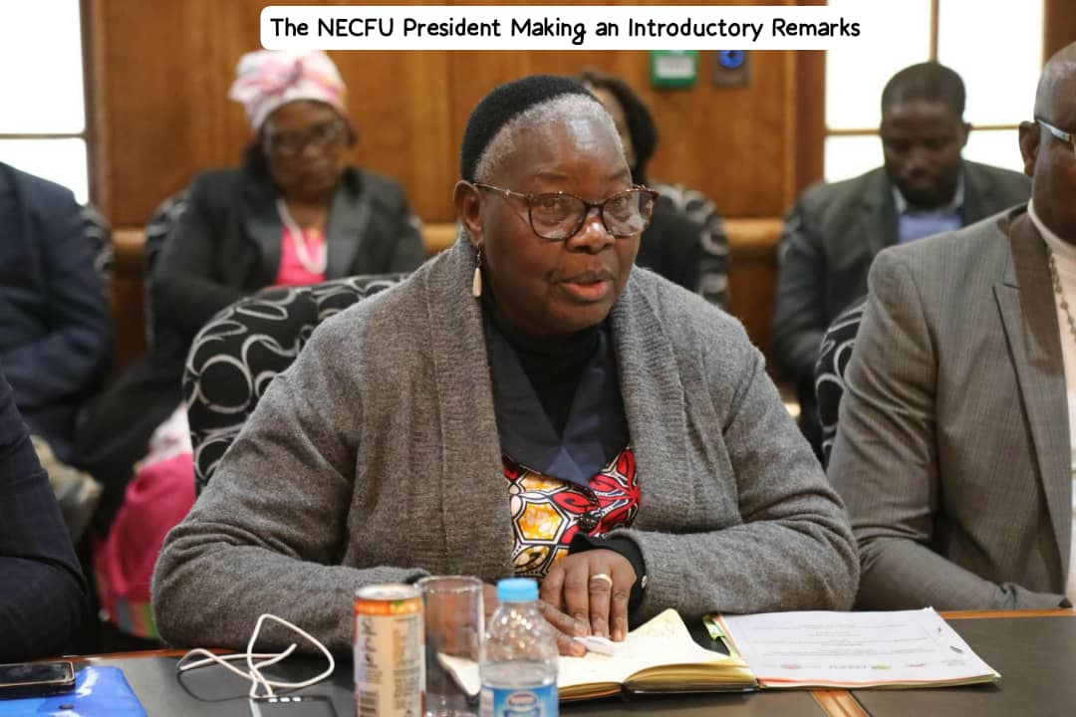
Farmers Engaging Her Excelency the Vice-president together with some key ministers

Slide 5
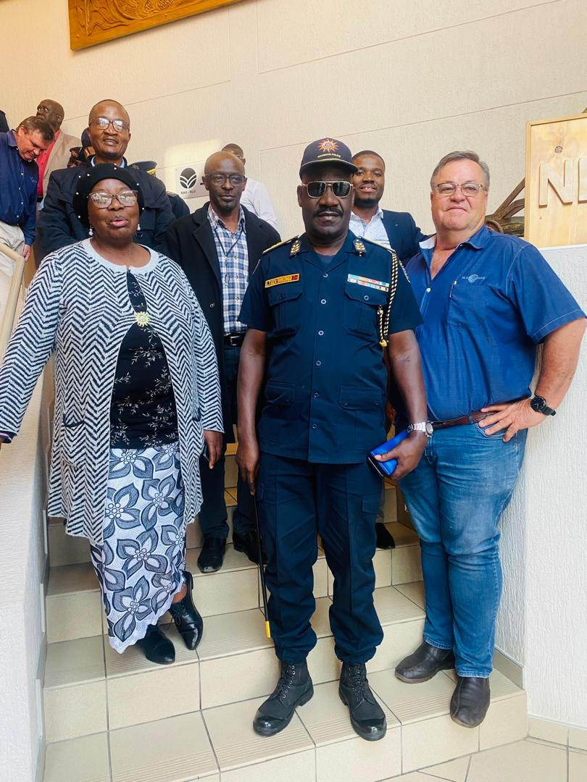
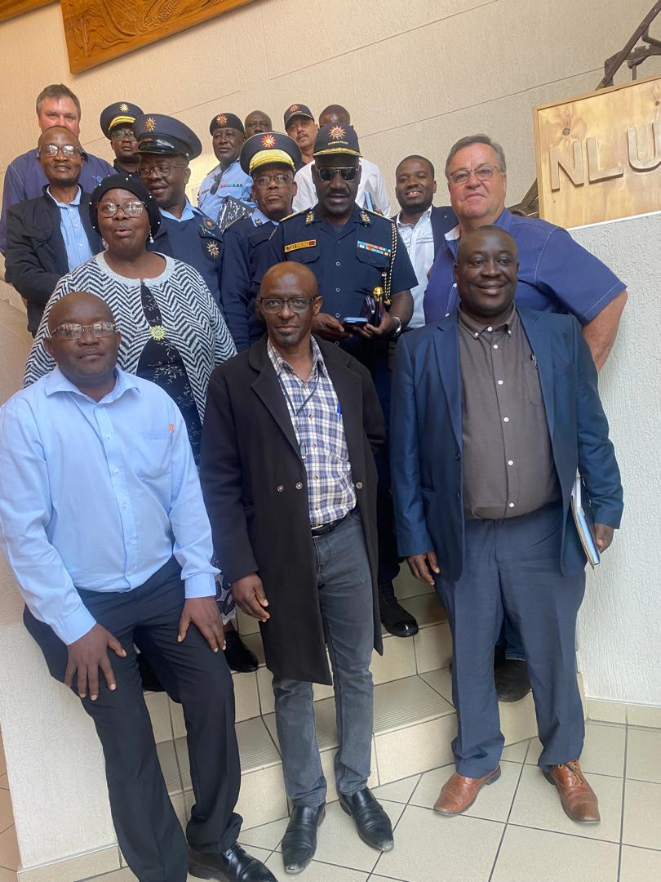
Farmers Unions on (MoU) with NAMPOL

